Slide 1
The Good Explorers
Fighting Modern Slavery
Through Technology

Slide 2
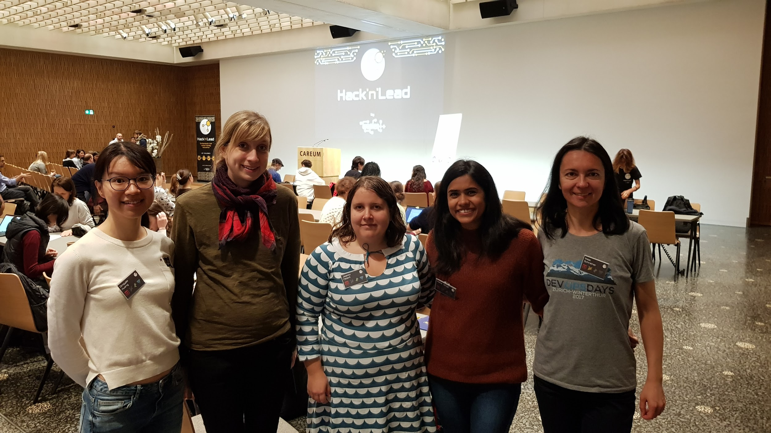
Notes:
Team introduction

Slide 3
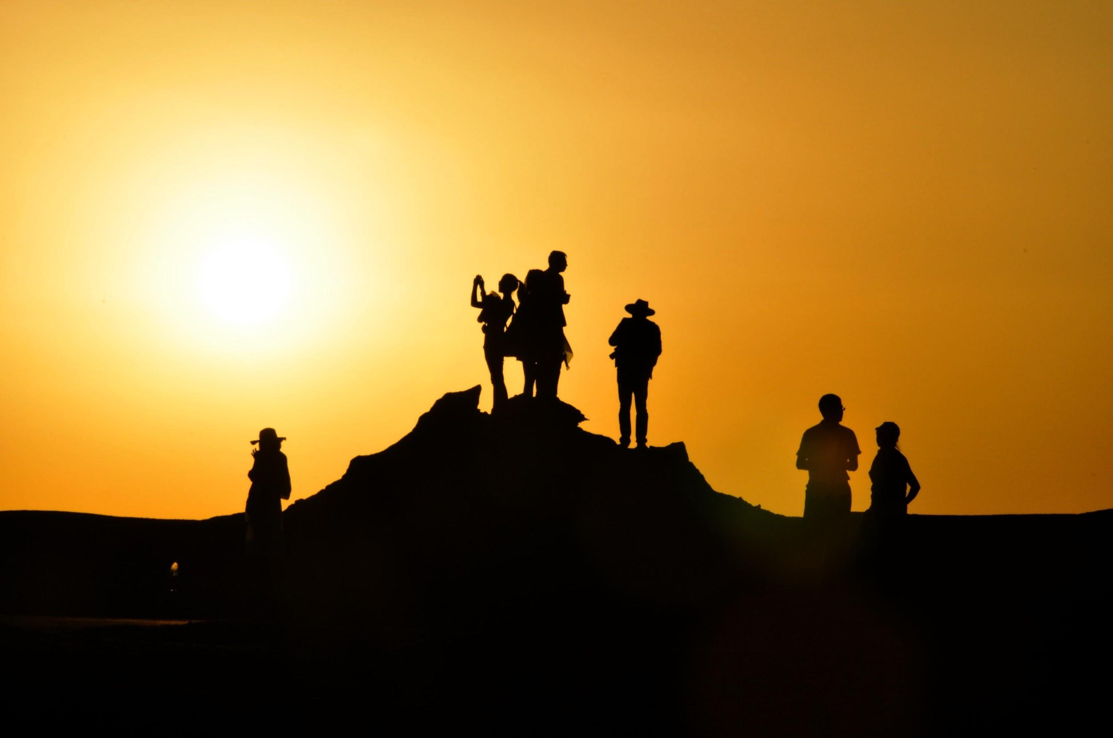
Notes:
2. VISION + why TR

Slide 4
VISION
Merge data on human trafficking
Merge database with news articles
Build the web interface
Localise and promote
Swiss market
Notes:
3. APPROACH

Slide 5
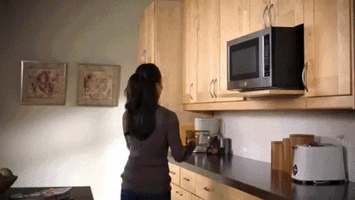

Slide 6

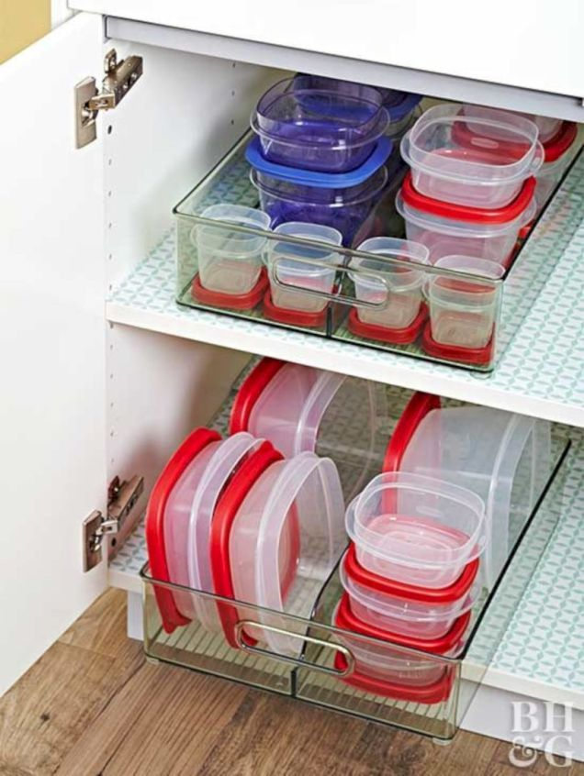
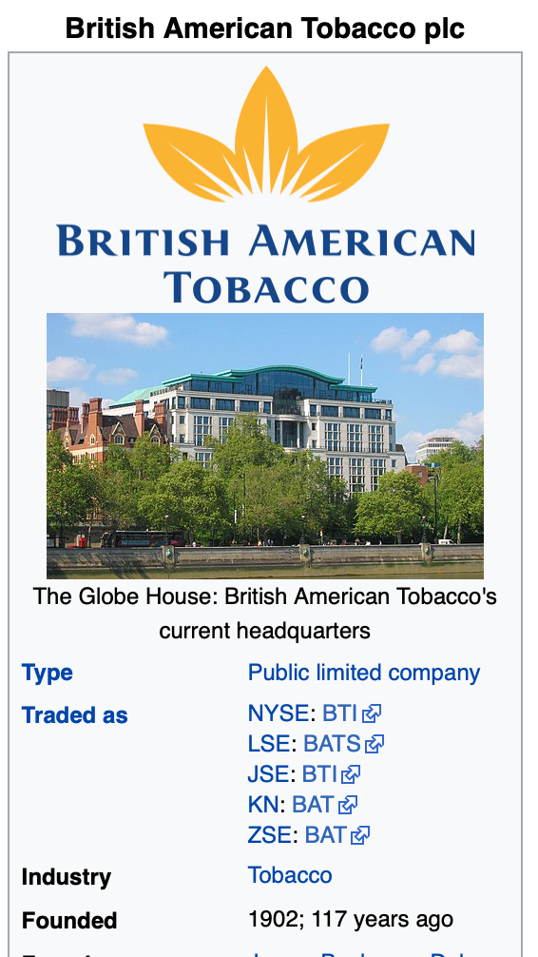


Thomson Reuters News APi

Slide 7
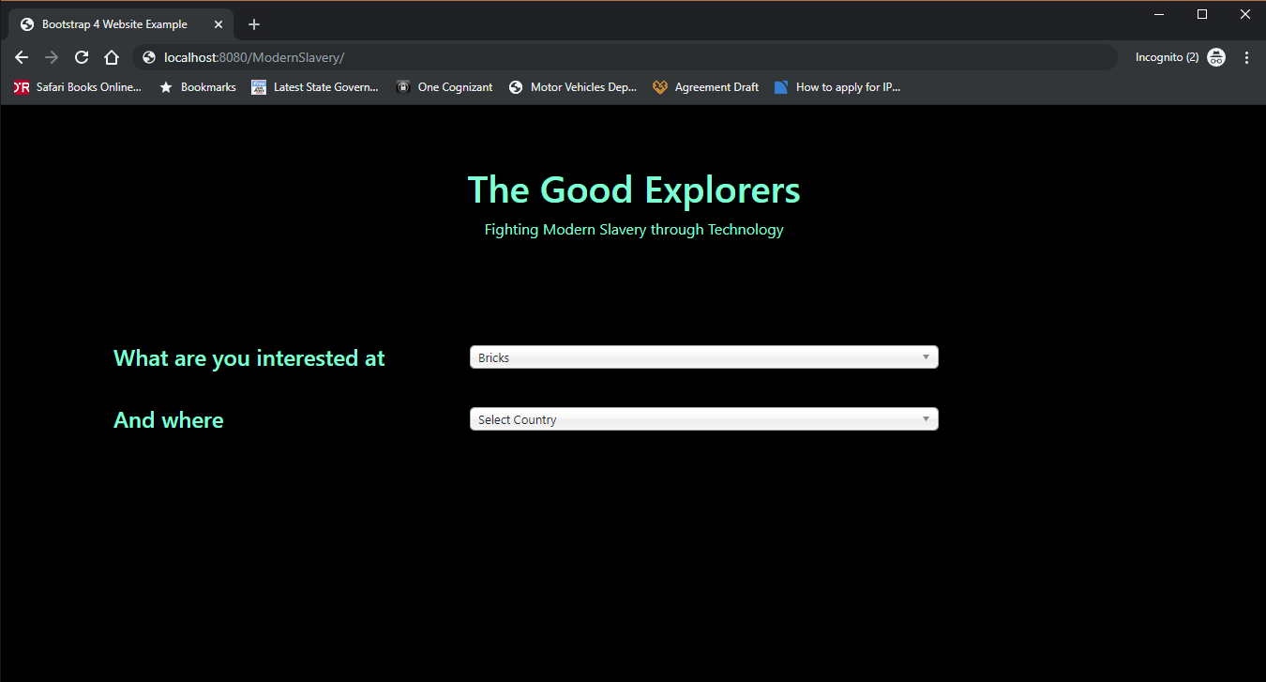
Notes:
4. SHOW THE PRODUCT

Slide 8
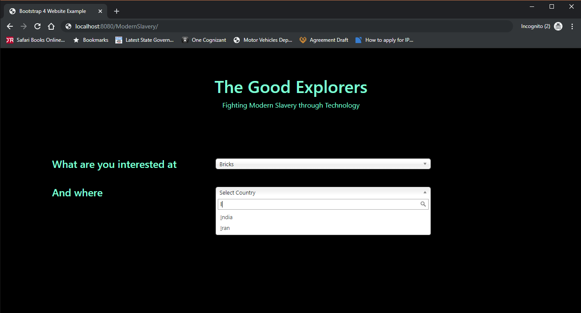

Slide 9
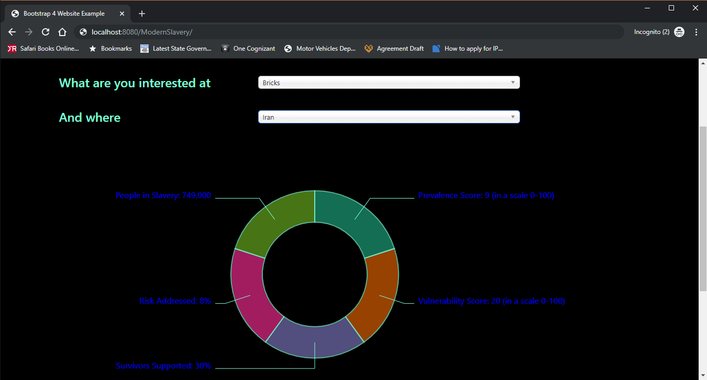

Slide 10

BUSINESS MODEL

Slide 11
FUTURE

Slide 12
749’000
People in slavery
Whoa! That’s a big number! 😒

Slide 13
Thanks!
Any questions?
You can find us at:
Tilia Ellendorff r.k.tilia@gmail.com
Neha Singh nehasingh1491@gmail.com
Chinya qingy.huang@gmail.com
Jasmin Heierli j.r.heierli@gmail.com
Maja Schreiner maja.schreiner@gmail.com

Slide 14
Credits
Special thanks to all the people who made and released these awesome resources for free:
Presentation template by SlidesCarnival
Photographs by Unsplash

Slide 15
Presentation design
This presentation uses the following typographies:
Titles: Kalam
Body copy: Merriweather
Download for free at:
https://www.fontsquirrel.com/fonts/kalam
https://www.fontsquirrel.com/fonts/merriweather
Download all the illustrated backgrounds here:
https://drive.google.com/file/d/1o22s-MVekIlxSb0Ldw_pcwMHDEnuUbT_/view?usp=sharing
You don’t need to keep this slide in your presentation. It’s only here to serve you as a design guide if you need to create new slides or download the fonts to edit the presentation in PowerPoint®

Slide 16

Free templates for all your presentation needs
For PowerPoint and Google Slides
100% free for personal or commercial use
Ready to use, professional and customizable
Blow your audience away with attractive visuals

